Slide 1
Bootcamp
Machine Learning

Slide 2
Rob Carrington
4 years as a Python developer
Worked in FinTech (@Q2eBanking)

Slide 3



Q2

Slide 4
Projects
Recommendation System
Audience Segmentation
Predicting Overdrafts

Slide 5


Slide 6

Class Goals
Theory behind important ML algorithms
Practice building models with scikit-learn

Slide 7
Theory
Concepts & terminology
Intuition behind underlying math
Understand tradeoffs between types of machine learning models

Slide 8
Practice
Machine learning workflow
Diagnosing commons problems
Steps to improve different types of models

Slide 9
Class format
15 minutes for lecture & demo
15 minutes for exercises
Pause to review & ask questions
Rinse and repeat

Slide 10
3 Myths about Machine Learning

Slide 11
Myth #1:
“Machine learning is new”

Slide 12
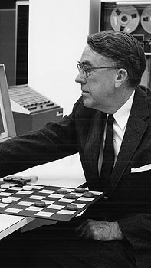
“The field of study that gives computers the ability to learn without being explicitly programmed”
- Arthur Samuel, 1959

Slide 13
Machine Learning: Why Now?
Computers are now fast and cheap
Improvements to old ideas (e.g. back-propagation)

Slide 14
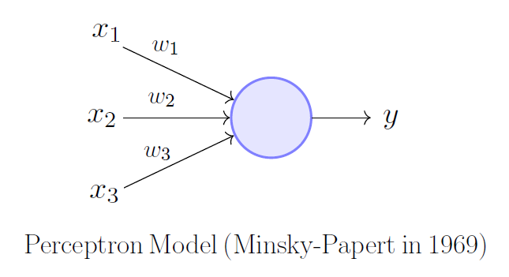

Slide 15
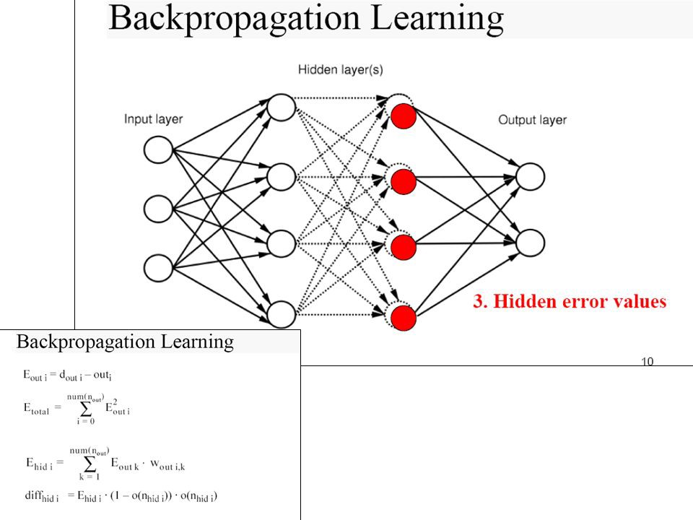

Slide 16
Myth #2:
“Machine learning = AI”

Slide 17
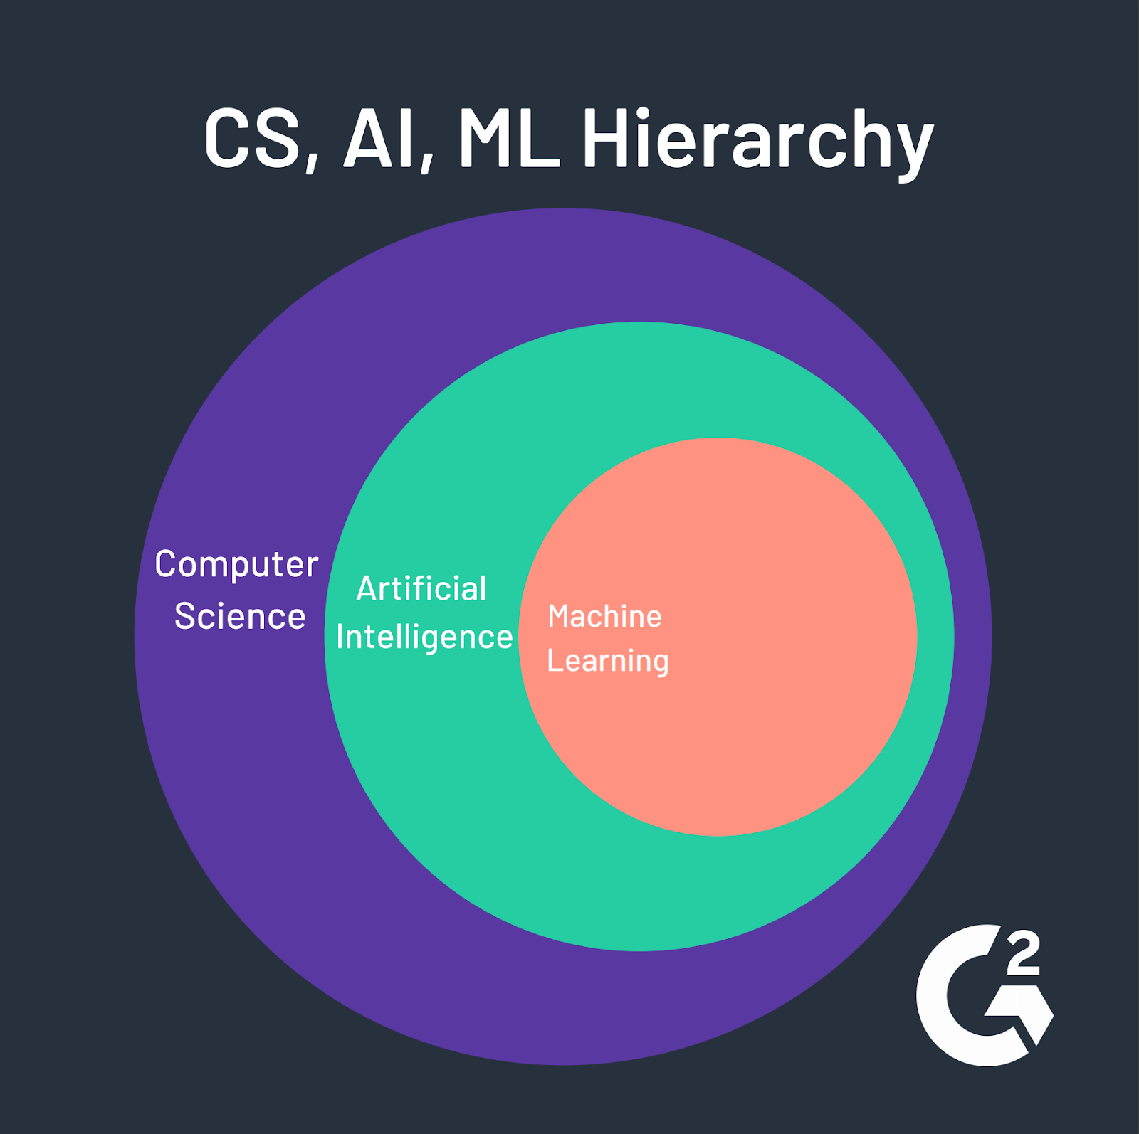

Slide 18
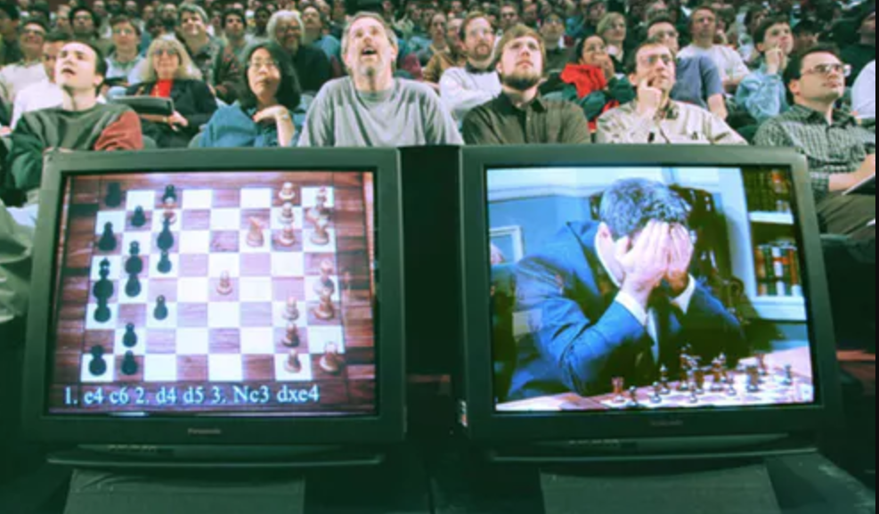
Intelligence = search algorithm (1956 - 1974)

Slide 19
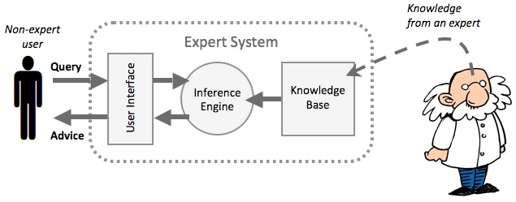
https://www.google.com/url?sa=i&source=images&cd=&ved=2ahUKEwi-kIfs_cHkAhWQxVkKHYNjDYQQjRx6BAgBEAQ&url=https%3A%2F%2Fwww.itgsnews.com%2Fcreating-expert-system-with-clips%2F&psig=AOvVaw2rT1XziARmYSMHLyhFbWN6&ust=1568058074270738
Intelligence = Rules + Deductive Logic (1980 - 1987)

Slide 20
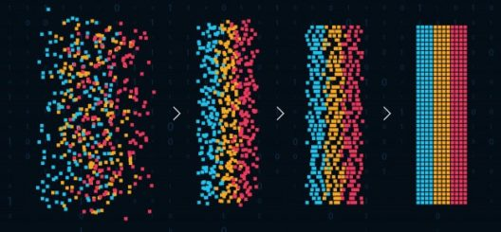
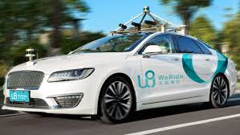
https://www.google.com/url?sa=i&source=images&cd=&ved=2ahUKEwi-kIfs_cHkAhWQxVkKHYNjDYQQjRx6BAgBEAQ&url=https%3A%2F%2Fwww.itgsnews.com%2Fcreating-expert-system-with-clips%2F&psig=AOvVaw2rT1XziARmYSMHLyhFbWN6&ust=1568058074270738
Intelligence = Pattern Recognition (1993 - today)

Slide 21

“If a typical person can do a mental task with less than one second of thought…
we can probably automate it either now or in the near future”
- ANDREW NG

Slide 22
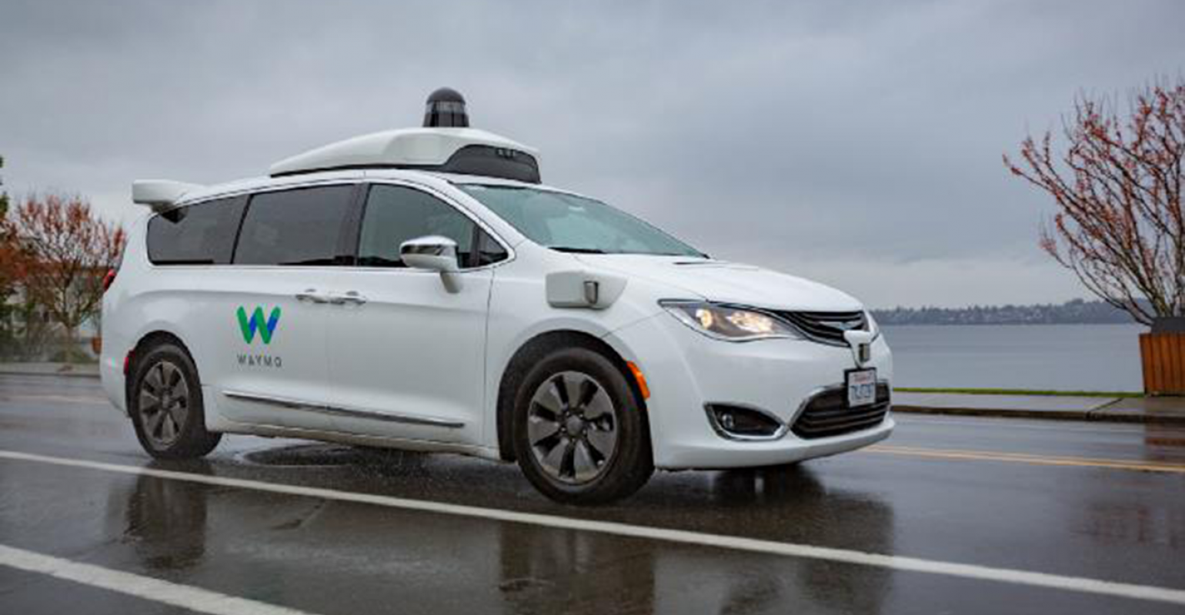
https://www.google.com/url?sa=i&source=images&cd=&ved=2ahUKEwi-kIfs_cHkAhWQxVkKHYNjDYQQjRx6BAgBEAQ&url=https%3A%2F%2Fwww.itgsnews.com%2Fcreating-expert-system-with-clips%2F&psig=AOvVaw2rT1XziARmYSMHLyhFbWN6&ust=1568058074270738
Self-Driving Cars

Slide 23

https://www.google.com/url?sa=i&source=images&cd=&ved=2ahUKEwi-kIfs_cHkAhWQxVkKHYNjDYQQjRx6BAgBEAQ&url=https%3A%2F%2Fwww.itgsnews.com%2Fcreating-expert-system-with-clips%2F&psig=AOvVaw2rT1XziARmYSMHLyhFbWN6&ust=1568058074270738

Slide 24
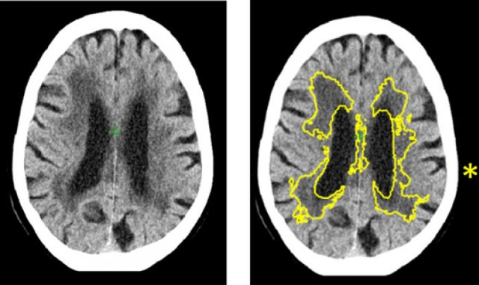
Medical Diagnostics

Slide 25
Myth #3:
“Machine learning will replace programming”

Slide 26
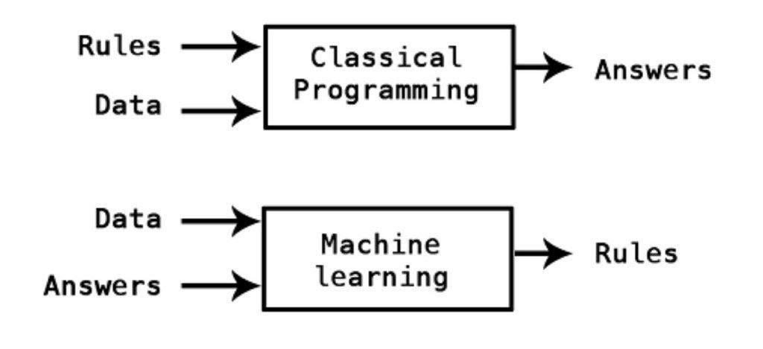

Slide 27
MACHINE LEARNING SHORTCOMINGS
Algorithms are often “black box”
Failures can be sudden and dramatic
Vulnerable to manipulation

Slide 28
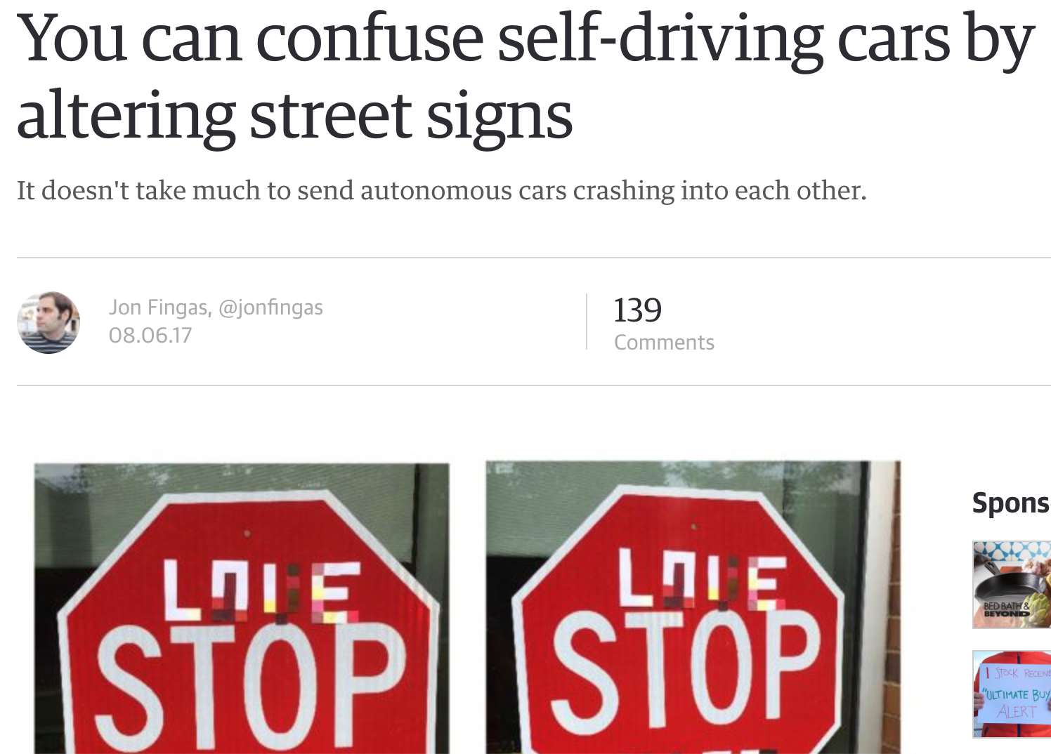

Slide 29


Slide 30
Concepts

Slide 31
Supervised vs Unsupervised
Supervised: model trained and evaluated based on previous “right answers”
Unsupervised: Finds patterns, with no right/wrong answers

Slide 32
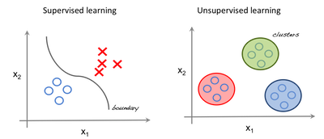

Slide 33
Regressions vs Classification
Regression outputs a number
Classification outputs a label

Slide 34
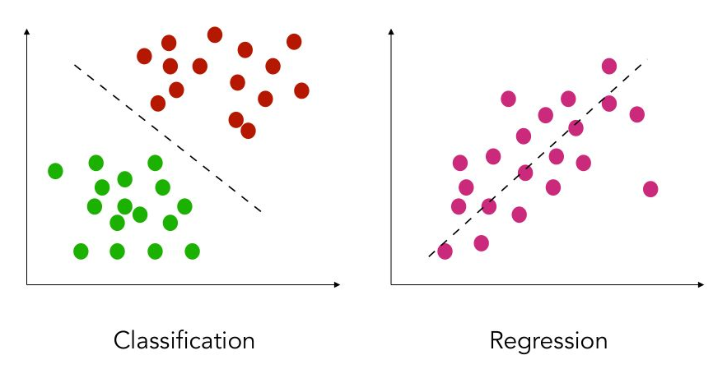

Slide 35
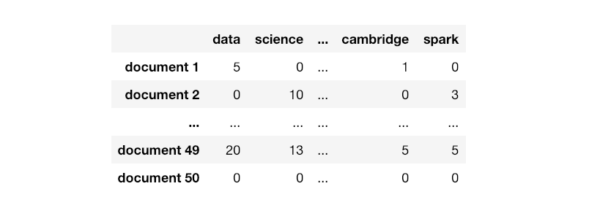

Slide 36
samples

Slide 37
features
samples

Slide 38
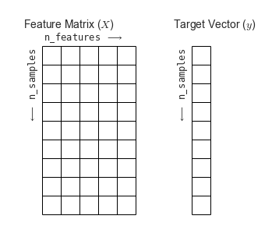

Slide 40

Wait! How do we test?

Slide 41
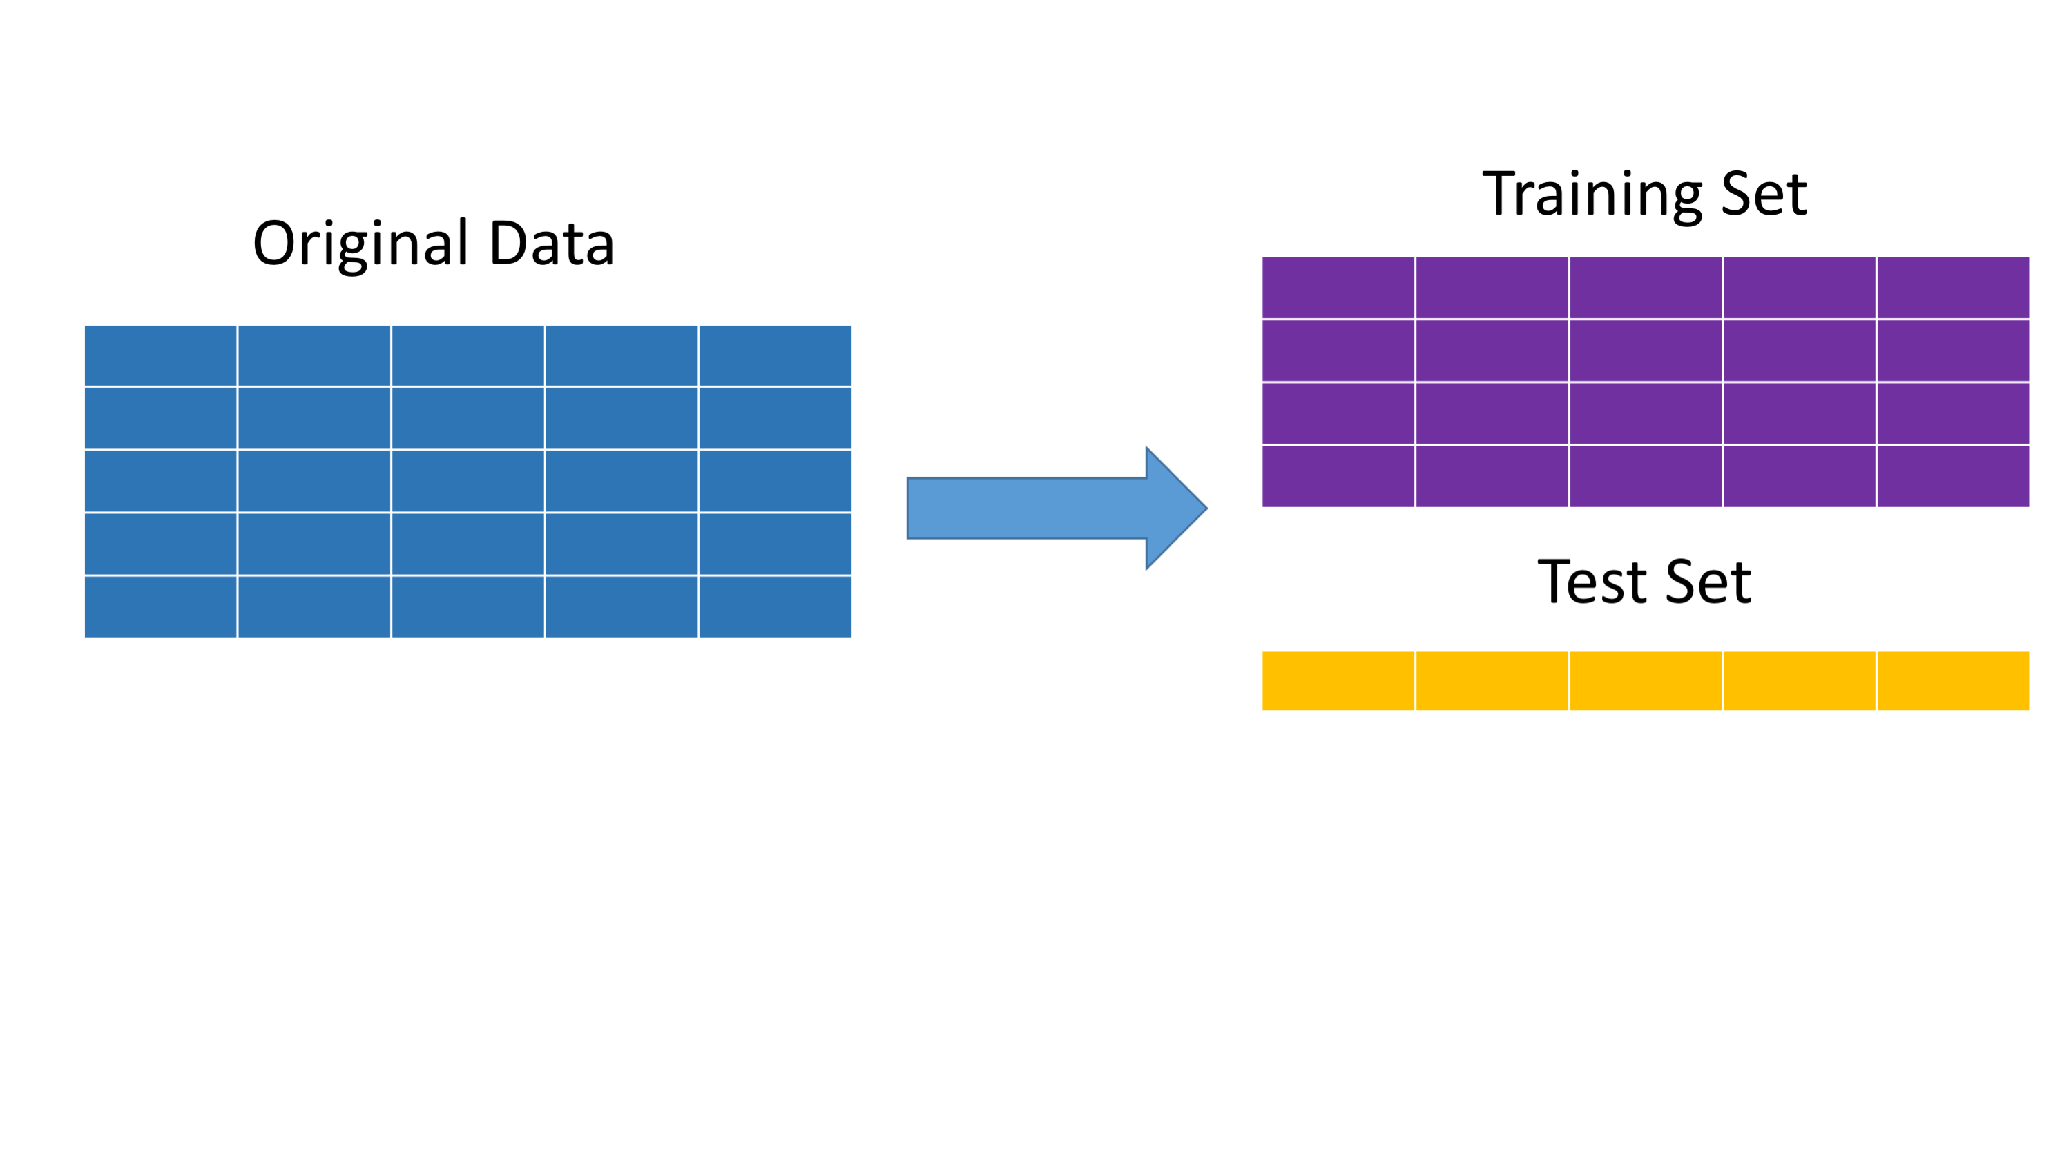
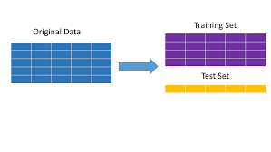

Slide 42
Quiz

Slide 43
Hands on
with Python

Slide 44
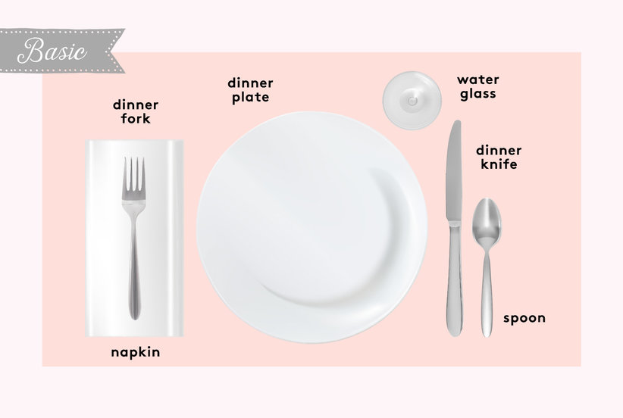
Setting the table

Slide 45
Pandas
Short for “panel data”
DataFrame concept from R

Slide 46
Dataframe
Similar to a spreadsheet
Columns are Numpy arrays with special index

Slide 47
importing Pandas
import pandas as pd

Slide 48
creating a Dataframe
df = pd.read_csv(“file_name”)

Slide 49
Grabbing a Column
df[‘profit’]

Slide 50
Dataframe from columns
columns = [‘revenue’, ‘profit’]
df[columns]

Slide 51
Dropping Columns
df.drop(columns=[‘revenue’])

Slide 52
Dividing your data
from sklearn.model_selection import train_test_split

Slide 55
Dividing your data
X_train, X_test, y_train, y_test = train_test_split(X, y)

Slide 56
Exercises

Slide 57
Non-Parametric Models

Slide 58
Non-parametric Model
Has parameters, despite name
Complexity of model grows with number of rows of data

Slide 59
Contrast: Linear Regression
y = 2x0 + 3x1 + … + 1

Slide 60
Benefits
No assumptions about probability distribution or functional form
Can fit very irregular patterns

Slide 61
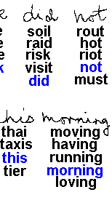
Recognition
Handwriting

Slide 62
Drawbacks
Low bias means it’s easy to overfit
Requires much more data to be accurate
“Model” keeps the entire dataset!

Slide 63
Distance &
Dimension

Slide 64
Distance-Based ML
K-Nearest Neighbors
Linear Regression
Polynomial Regression
etc

Slide 65

Review
Distance

Slide 66
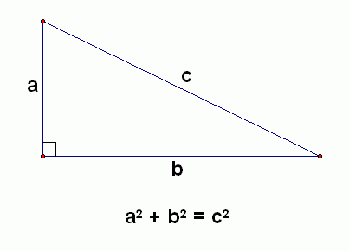

Slide 67
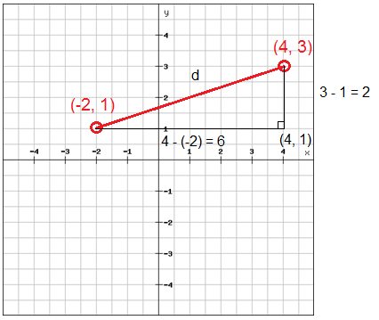

Slide 68
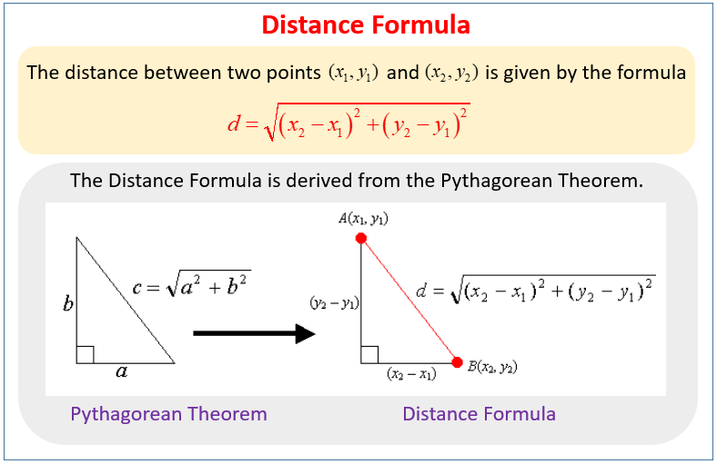

Slide 69
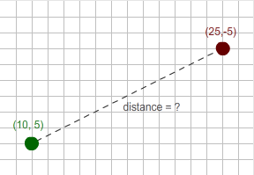

Slide 70
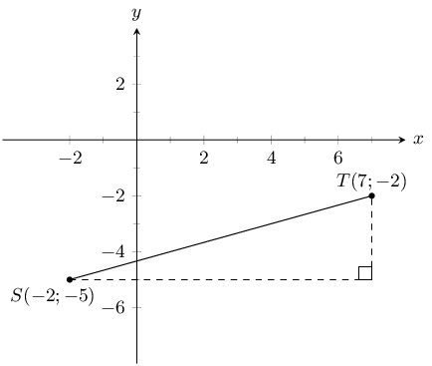

Slide 71
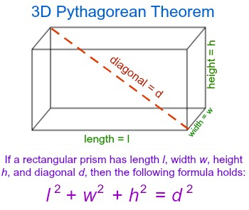

Slide 72
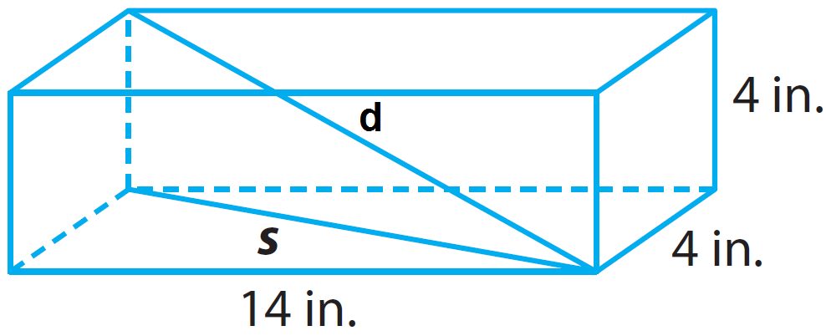

Slide 73
Dimension
Degrees of freedom
How many numbers to specify a location?

Slide 74
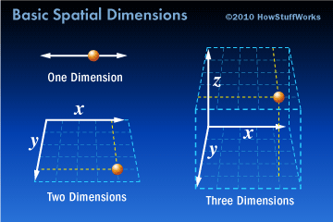

Slide 75
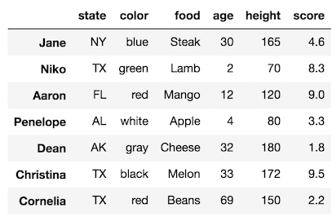
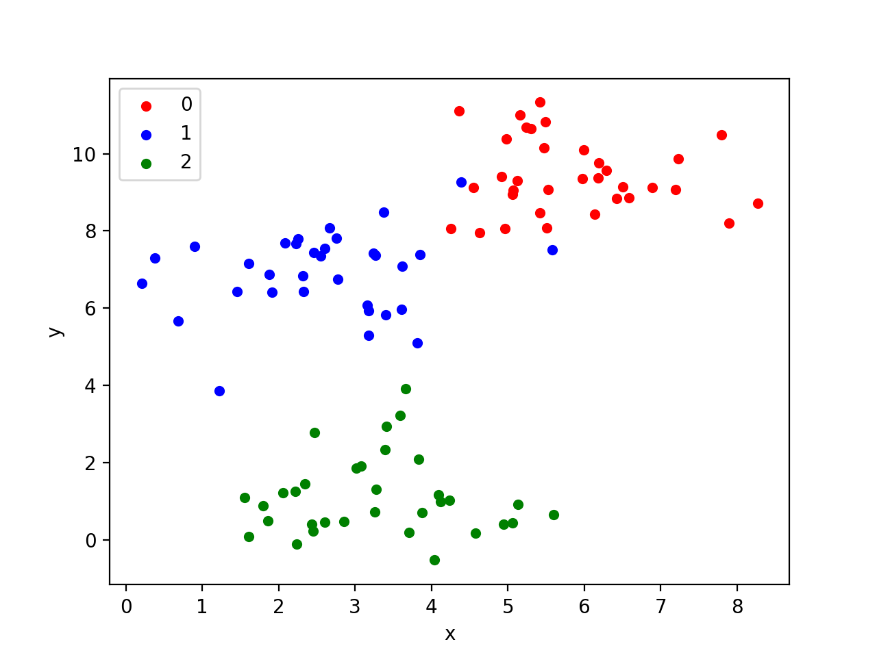

Slide 76
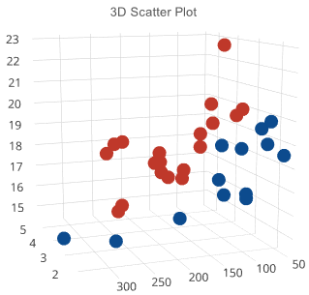

Slide 77
?

Slide 78
K-nearest Neighbors

Slide 79
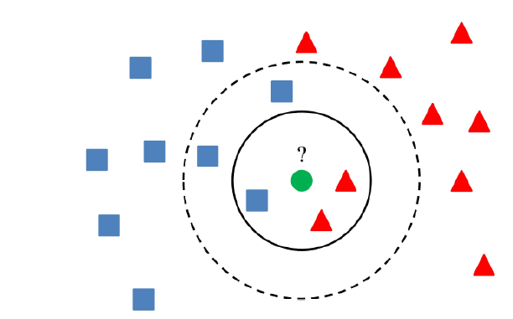

Slide 80
Pros of KNN
Simple to understand, no training step
Can do regression or classification
Easy to do multi-class classification
Easy to add new data

Slide 81
Cons of KNN
Numerical inputs only
Major problems with imbalanced data
Model slows down with more data

Slide 82
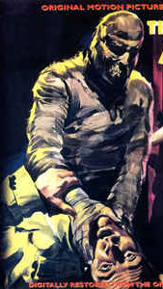
Dimensionality
the curse of

Slide 83
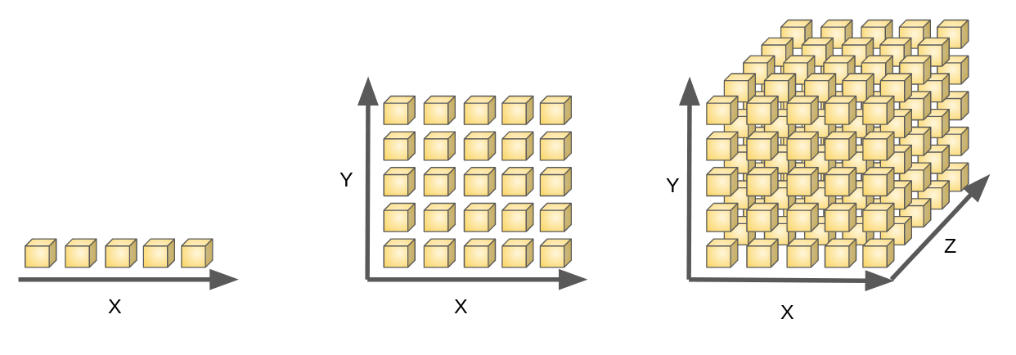

Slide 84
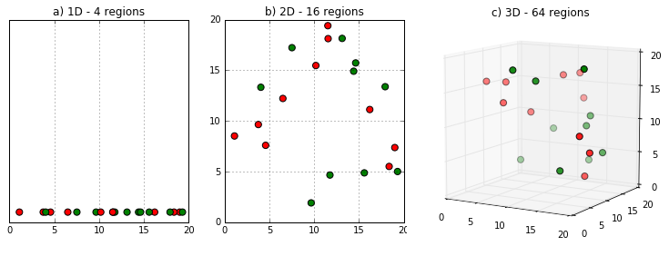

Slide 85
Exercises

Slide 86
Evaluating
Classifiers

Slide 87
Cannot use Regression metrics
Outputs are classes, not numbers
“Amount of error” is a bad fit

Slide 88
Accuracy
% of samples correctly classified
Does not tell you WHERE error is

Slide 89
Confusion Matrix
Grid comparing predicted VS actual
Shows where your errors lie
Correction classification on diagonal

Slide 90
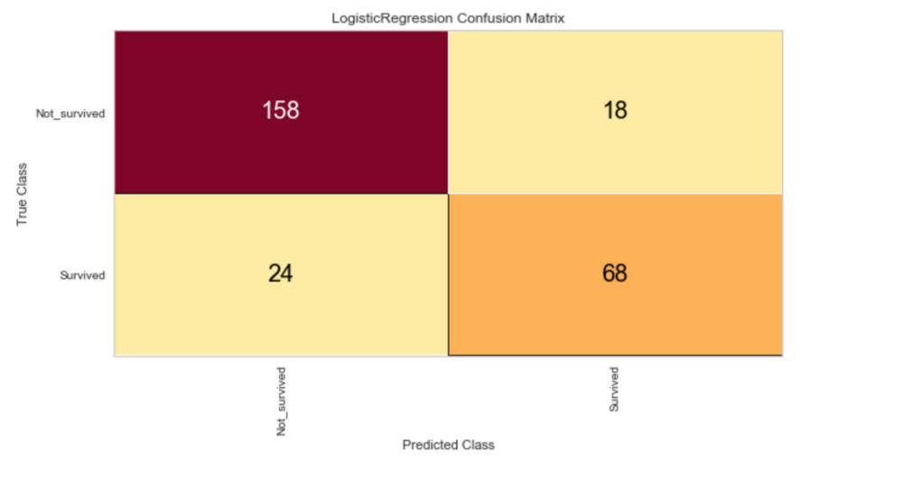

Slide 91
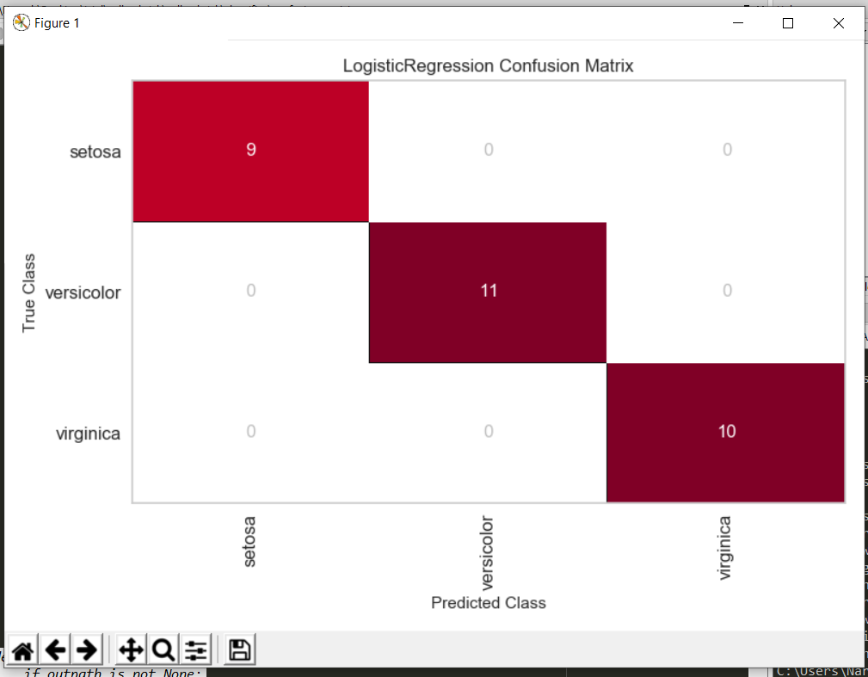
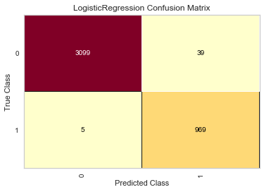
Confusion Matrix

Slide 92
Class prediction Error
Derived from the confusion matrix
Sometimes easier to interpret

Slide 93
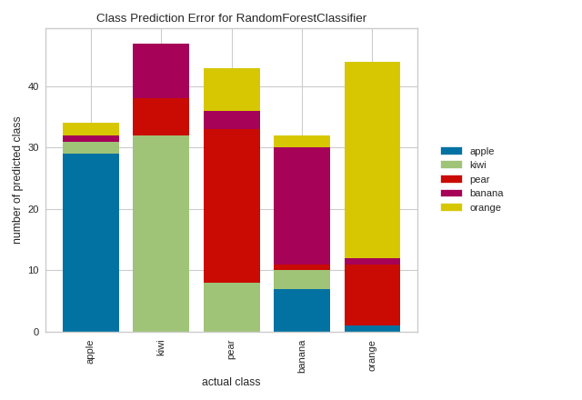

Slide 94
Choosing a Threshold
Business decision: Which type of errors are more costly?
Equal weight? Closest point on curve to top-left corner

Slide 95
ROC Curve
Short for “Receiver operating characteristic”
Shows effect of changing probability threshold

Slide 96
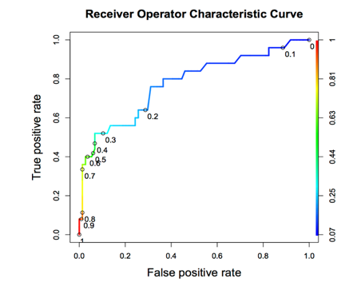

Slide 97
Area Under the curve
Total AUC is a measure of classifier power
1.0 is perfect, 0.5 is as bad as random chance

Slide 98
Exercises

Slide 99
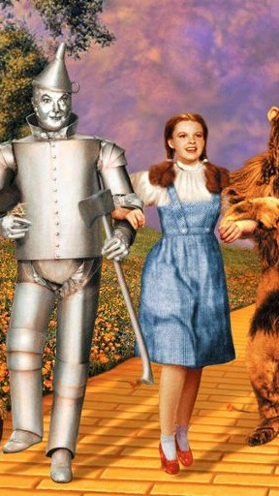
Yellowbrick
Introducing

Slide 100
Yellowbrick
Diagnostic visualizations! Automatic!
Built to integrate with scikit-learn

Slide 101
Example from data
from yellowbrick.features import rank2d
visualizer = rank2D(X)
visualizer.poof()

Slide 102
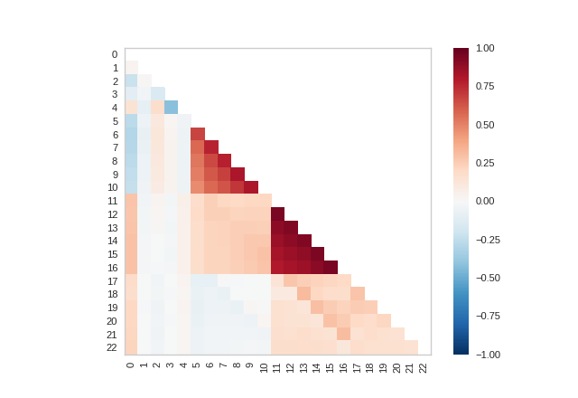

Slide 103
Exercises

